Slide 1
Optimized Pose-Based
Gait Analysis
for Surveillance
Research presentation deck
Apoorva Parashar • Anubha Parashar • Vidyadhar Aski
Second International Conference on Innovations in Computational Intelligence and Computer Vision — ICICV 2021

Slide 2
Conference presentation credential
Presented at ICICV 2021, organized by Manipal University Jaipur with Springer
“Optimized Pose-Based Gait Analysis for Surveillance”
Presented by Anubha Parashar
ICICV-2021, Aug 05–06, 2021
Focus: marker-free gait analysis for surveillance scenarios
ICICV 2021 • Optimized Pose-Based Gait Analysis for Surveillance • 2

Slide 3
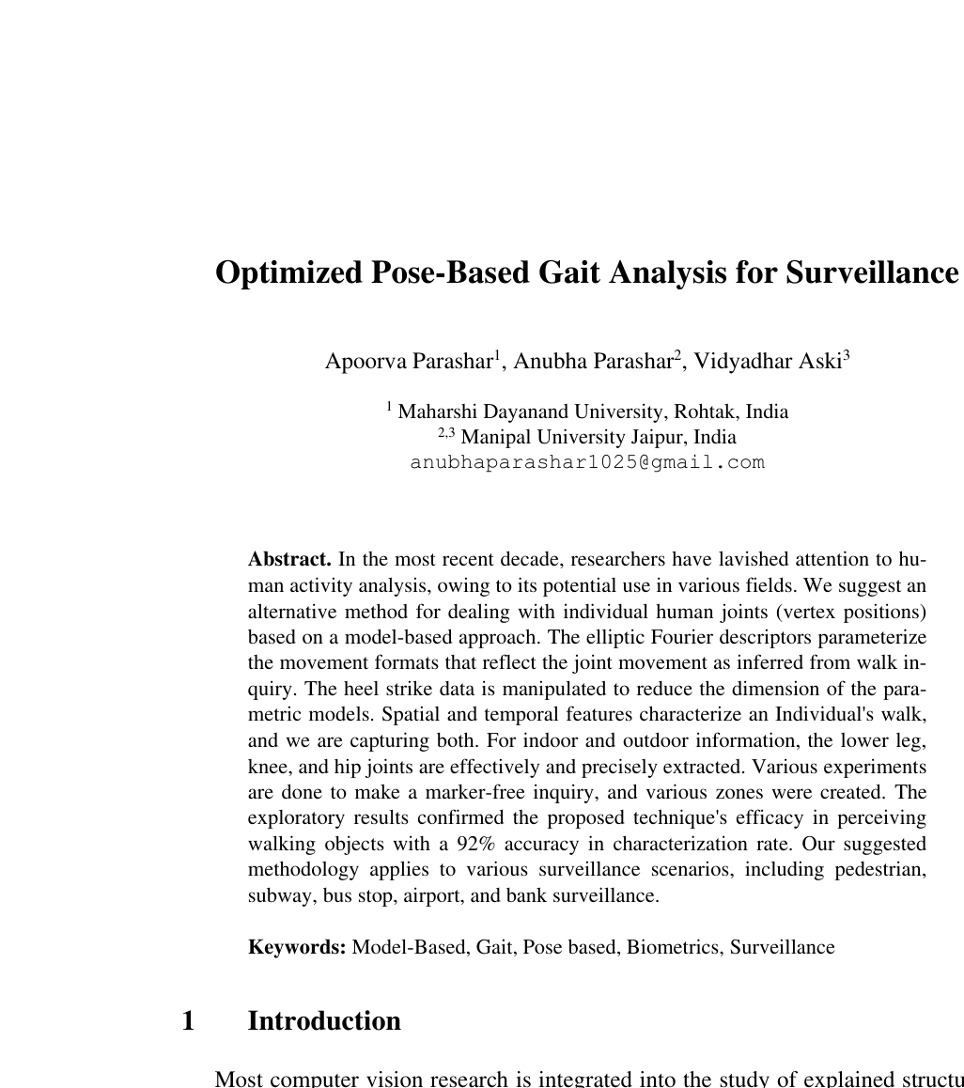
Why gait analysis matters in surveillance
Gait can identify or characterize people even when face-level detail is unavailable
Research problem
Surveillance videos often lack clear face or fingerprint-style biometric information.
Walking patterns provide spatial and temporal cues useful for recognizing moving people.
The challenge is to extract joint positions without markers, sensors, or controlled clothing.
Key challenge: robust joint extraction under clothing, view changes, segmentation errors, and indoor/outdoor capture conditions.
Based on the paper introduction and abstract.
ICICV 2021 • Optimized Pose-Based Gait Analysis for Surveillance • 3

Slide 4
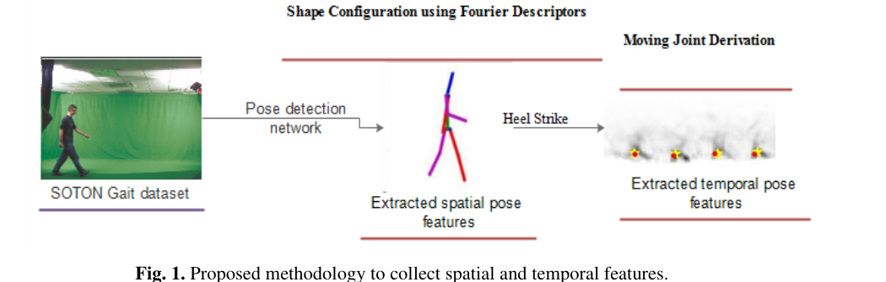
Proposed methodology
Pose-based gait pipeline using spatial pose features and heel-strike temporal cues
Pipeline interpretation
SOTON gait video is converted into extracted spatial pose features; heel-strike events then provide temporal cues for joint movement derivation.
Visual source: Fig. 1 from the uploaded ICICV-2021 paper.
ICICV 2021 • Optimized Pose-Based Gait Analysis for Surveillance • 4

Slide 5
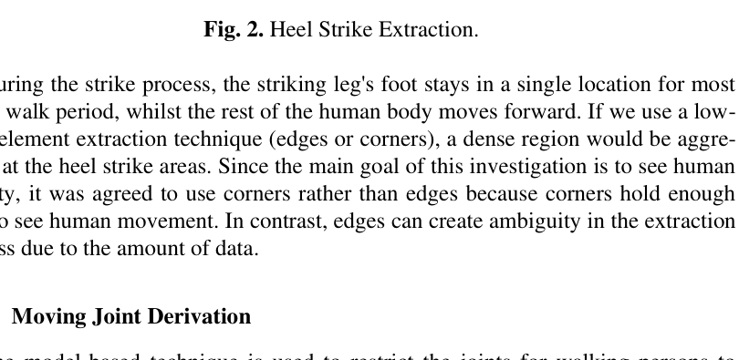
Technical core: from shape to joints
The method combines Fourier shape modeling with heel-strike extraction
1
Shape configuration
Elliptic Fourier descriptors parameterize moving body shapes and reduce complex shape boundaries into compact descriptors.
2
Heel-strike extraction
Heel strikes indicate gait periodicity and help constrain the search space for lower-limb joint positions.
Heel-strike extraction visual
Dense corner evidence around the heel helps identify the periodic contact point in walking.
3
Moving joint derivation
Evidence gathering and Hough-style voting derive joint locations across frames, then local extraction refines them.
Visual source: Fig. 2 from the uploaded paper.
ICICV 2021 • Optimized Pose-Based Gait Analysis for Surveillance • 5

Slide 6
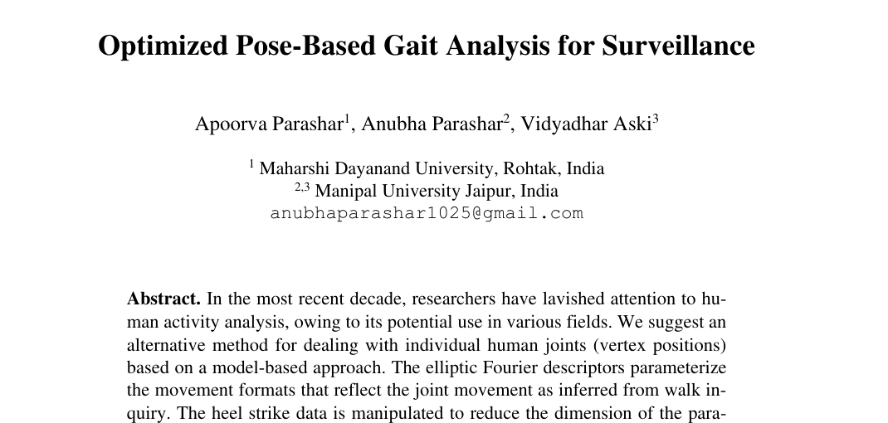
Experimental setup
Evaluation uses SOTON gait sequences with indoor and outdoor examples
Data and evaluation
120 unique subjects from the SOTON database.
100 subjects captured indoors under controlled conditions.
Additional outdoor subjects captured in natural light.
Lower-leg, knee, and hip joint paths analyzed over the gait cycle.
Paper title page
Authors: Apoorva Parashar, Anubha Parashar, Vidyadhar Aski
What is measured?
Joint localization quality, heel-strike extraction, and recognition/classification performance from gait-derived features.
ICICV 2021 • Optimized Pose-Based Gait Analysis for Surveillance • 6

Slide 7
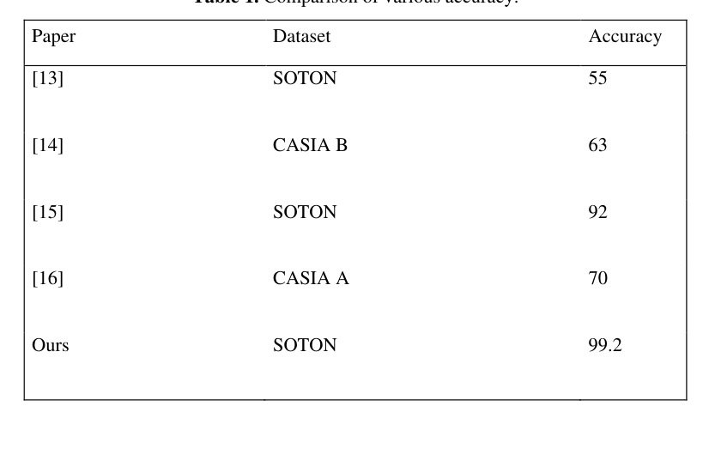
Reported results
The method demonstrates strong heel-strike extraction and promising recognition performance
99.2%
heel-strike extraction reported over 514 strikes
0.52%
average heel-strike position error normalized by subject height
1.36%
mean extracted joint-location error versus manual labels
Visual source: results table from page 5 of the paper.
92%
classification rate stated in the abstract/conclusion for person recognition
ICICV 2021 • Optimized Pose-Based Gait Analysis for Surveillance • 7

Slide 8
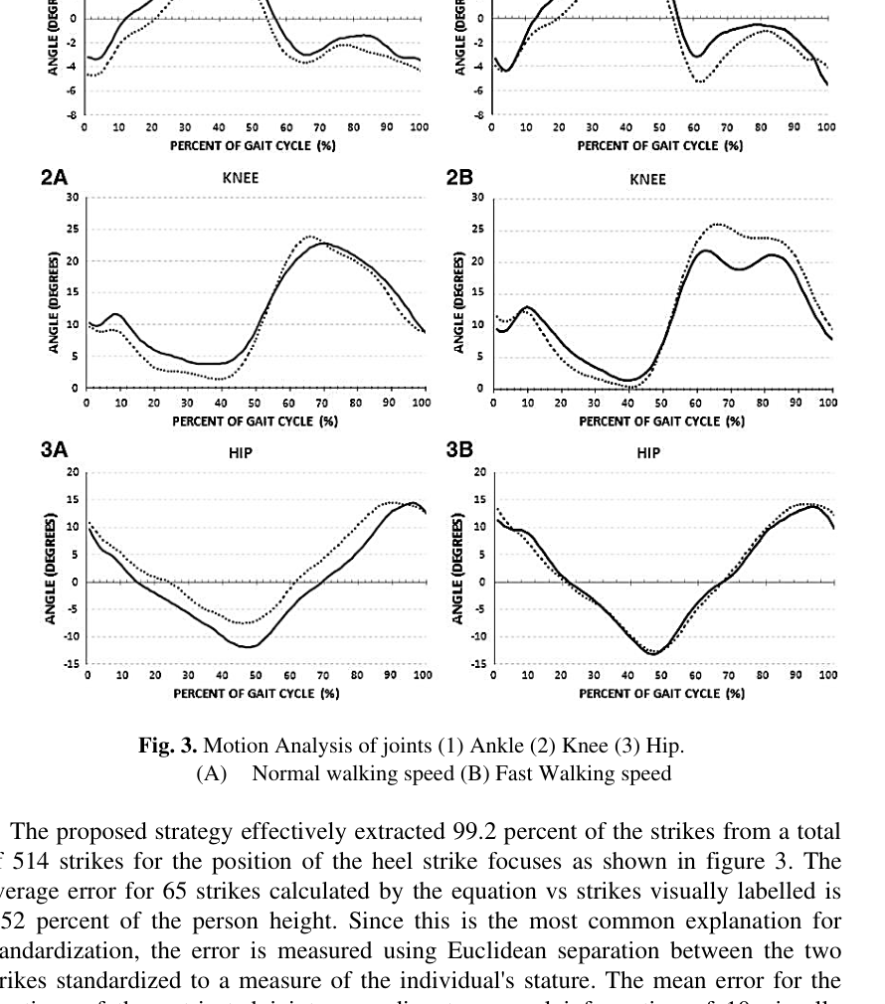
Motion analysis of joints
Extracted joint trajectories show ankle, knee, and hip patterns across the gait cycle
What the plots show
Ankle, knee, and hip angle trajectories are measured over a normalized gait cycle.
Normal walking speed and fast walking speed are compared side-by-side.
The extracted trajectories remain close to expected biomechanical movement patterns.
Takeaway
The model-based pipeline is not only a classifier: it gives interpretable joint-level motion evidence that can be inspected in surveillance analysis.
ICICV 2021 • Optimized Pose-Based Gait Analysis for Surveillance • 8

Slide 9
Main contribution and impact
A marker-free, model-based approach to gait analysis for practical surveillance settings
Core contribution
The paper proposes a method that extracts moving human joints using model-based evidence gathering, Fourier descriptors, and heel-strike cues.
Why it matters
Works without physical markers or wearable sensors.
Targets both indoor and outdoor surveillance environments.
Provides interpretable joint trajectories, not only a final identity score.
Application areas mentioned in the paper include pedestrian, subway, bus stop, airport, and bank surveillance.
ICICV 2021 • Optimized Pose-Based Gait Analysis for Surveillance • 9

Slide 10
Thank You
Questions & Discussion
Optimized Pose-Based Gait Analysis for Surveillance
ICICV 2021 • Manipal University Jaipur • Springer

